Slide 1

H1-B Visa Prevailing Wage Prediction
Team Members:
Shehzada Alam
Shreyas Wankhede
Sagar Bhutada
Sameer Pophali
Urvi Parekh
Manavi Agarwal

Slide 2
Index:
What’s H-1B Visa ? & what’s the problem.
What’s our objective?
Features Description.
Data Analysis & Visualization
Analyzing features
Workflow
Performance Evaluation Metrics

Slide 3
What’s H-1B Visa ? & What’s the problem.
The U.S. Department of Labor’s Office of Foreign Labor Certification releases annual data on various visa applications, including the H-1B. The H-1B is a non-immigrant visa that allows U.S. companies and organizations to temporarily employ foreign workers in specialty occupations.
Problem:
One of the biggest things to consider, when somebody applies for Labor Condition Application ( LCA ) to file H1B visa is to look at the minimum wage or prevailing wage in the area you plan to work on H1B visa.
For employer setting up wage could be tedious since it depends upon multiple factors like location, job title, No. of workers etc. setting up wage lower than minimum could lead to H1-B rejection and even setting higher wage could result to the loss for a company.
Sources: https://public.enigma.com/datasets/h-1-b-visa-applications-2017/e1ee0ae8-13f4-444f-804e-9a429b32f424

Slide 4
What’s our objective?
End-user: Employer
Objective: The objective of this project is to predict the prevailing wage that is at optimum.
Dataset: The H-1B Visa Application dataset include fields like Visa Class, Status, Employer location, Prevailing Wage, Total number of workers, employment start and end date etc. which are the applications for the H-1B visa lottery who was accepted into the lottery but not who won a visa.
The dataset contains 624,650 rows and 53 fields.
Metric Consideration: RMSE, MAE

Slide 5
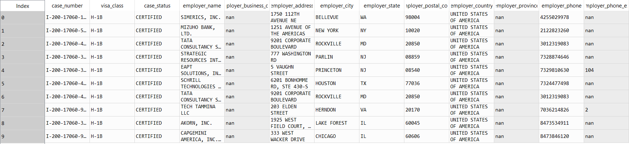
Sample Data

Slide 6
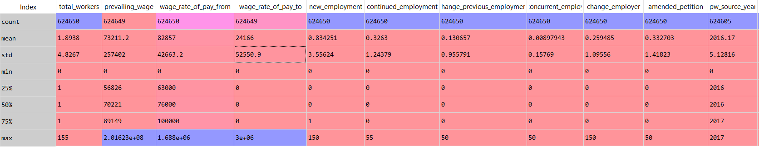
Features Description.

Slide 7
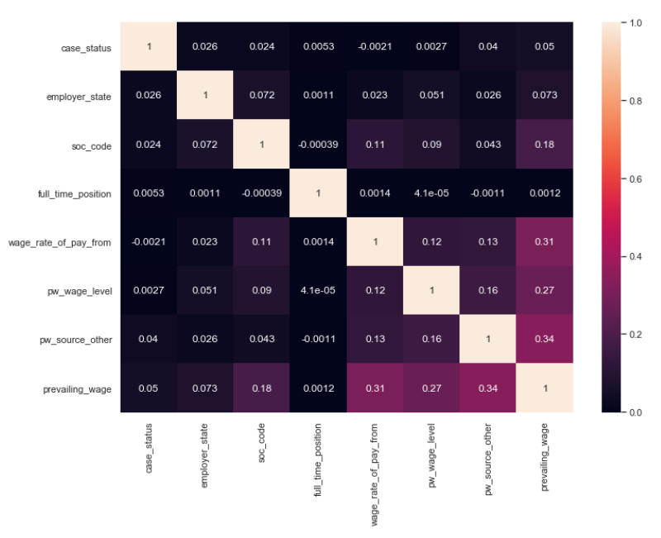
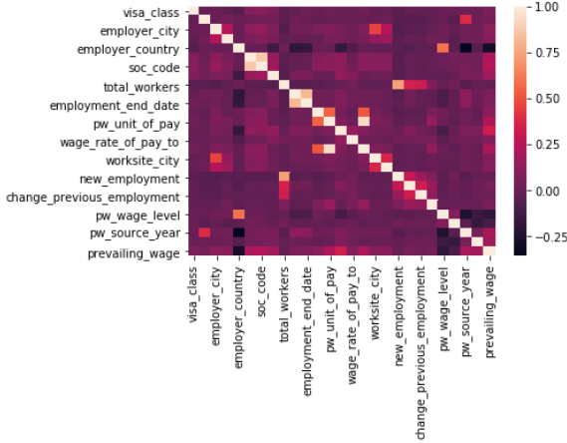
Data Analysis and Visualization

Slide 8
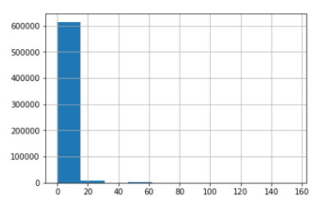
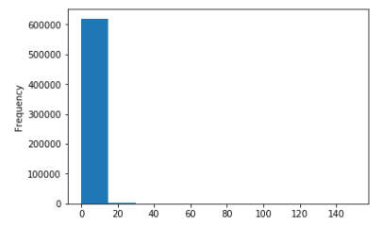
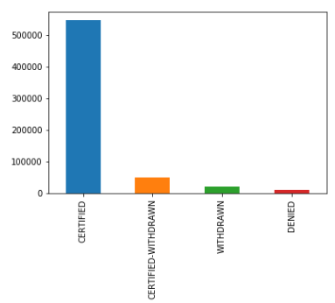
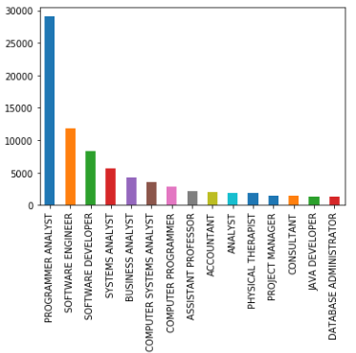
Analyzing features
total_workers
new_employment
case_status
job_title

Slide 9
Workflow:
Loading Data
Data Cleaning
EDA
ML Model Building
Feature Selection
Feature Engineering

Slide 10
Performance Evaluation Metrics
Model | RMSE |  | Adjusted R2 Score | MAE
 | Train | Test | 0.77584 | Train | Test
Linear Regression | 12832.27 | 12876.97 |  | 8145.0 | 8181.0

Slide 11
Thank you!

